Slide 1
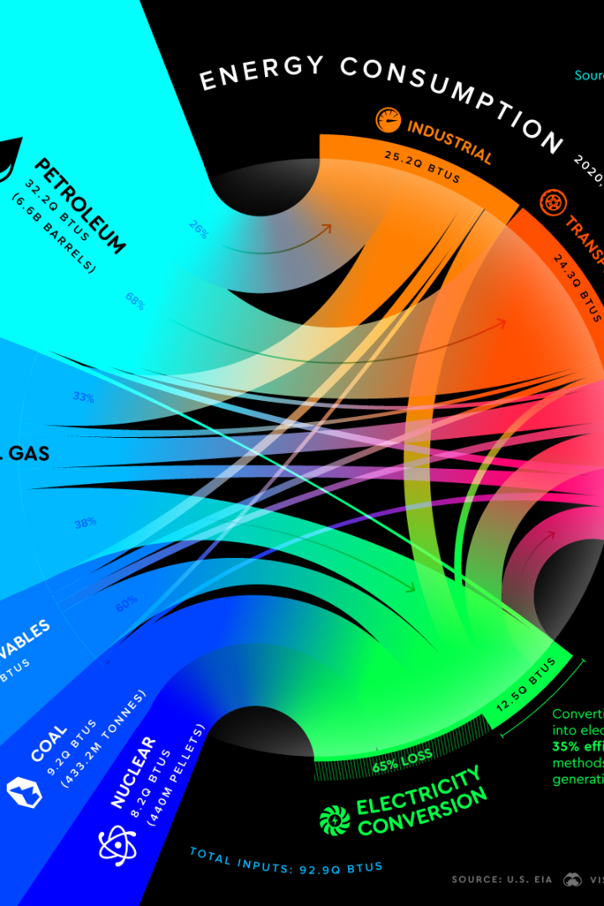
Energy Consumption Analysis
Welcome to our presentation on energy consumption! Join us as we explore the fascinating world of electricity and its impact on our daily lives.
Sai Subrahmanya Akhil Badampudi
Jash Nimesh Dharia Jaliwala
Masaki Hosohata
Sampada Regmi
Neha Sharma

Slide 2
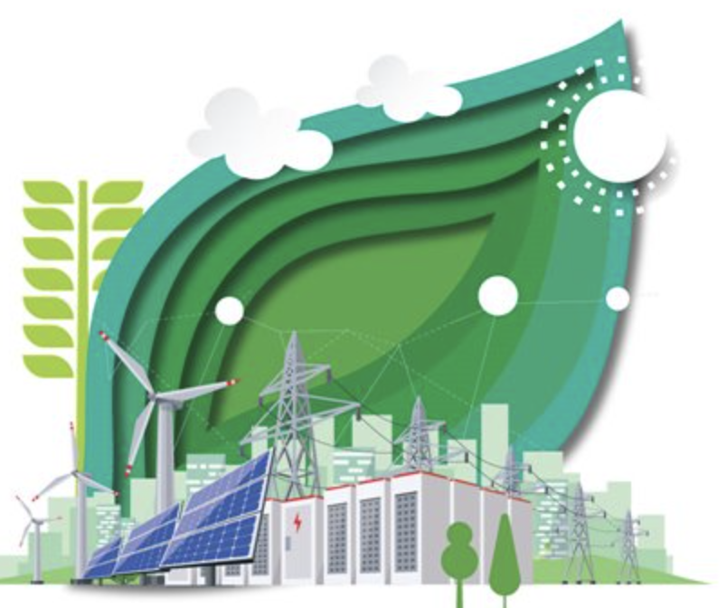
Understanding Our Energy Challenge
As global temperatures rise, so does the demand for electricity, particularly during the hot summer months
In South Carolina and parts of North Carolina, we are anticipating record-breaking energy usage as our customers seek to cool their homes
Our electrical grid is robust, yet the projected demand next July may push its limits, risking blackouts
Our goal
To reduce energy usage if next summer is ‘extra hot’, so that they can meet demand
LETS SEE HOW?

Slide 3
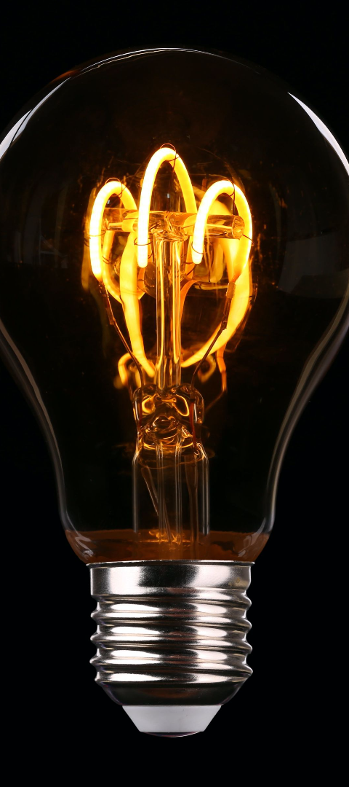
Understanding Energy Consumption
1
Data Collection
Gathered energy consumption data of housing, energy consumption as well as weather conditions of South Carolina & parts of North Carolina.
2
Data Cleaning
Preprocessed and cleaned the dataset with the help of county , building id and county. Removed outliers and ensured data consistency for analysis.
3
Data Variables
Explored different variables such as time of day, weather conditions, and household size to study their impact on energy consumption.

Slide 4


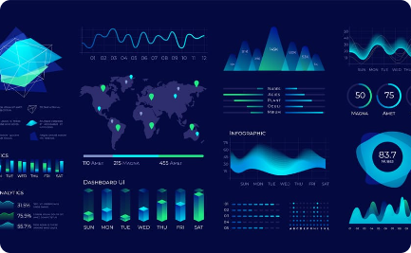
Understanding Energy Consumption
Data Cleaning & Transformation
Exploratory Data Analysis
Data Visualization
Performed data preparation techniques like scaling, standardizing, and handling missing values to ensure accurate analysis.
Conducted in-depth analysis to identified outliers as well as found correlation between some predictor variables and the outcome variables.
We tried finding patterns in daily energy consumption and visualized the energy levels per city

Slide 5
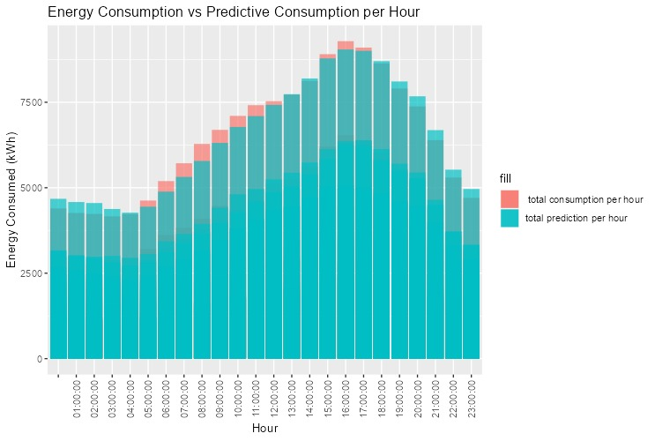
Daily Energy Consumption Trend
By observing this line's movement, we can identify patterns such as cyclical trends (like higher usage on specific days of the week), spikes (days with unusually high energy consumption), or troughs (days with particularly low usage).

Slide 6
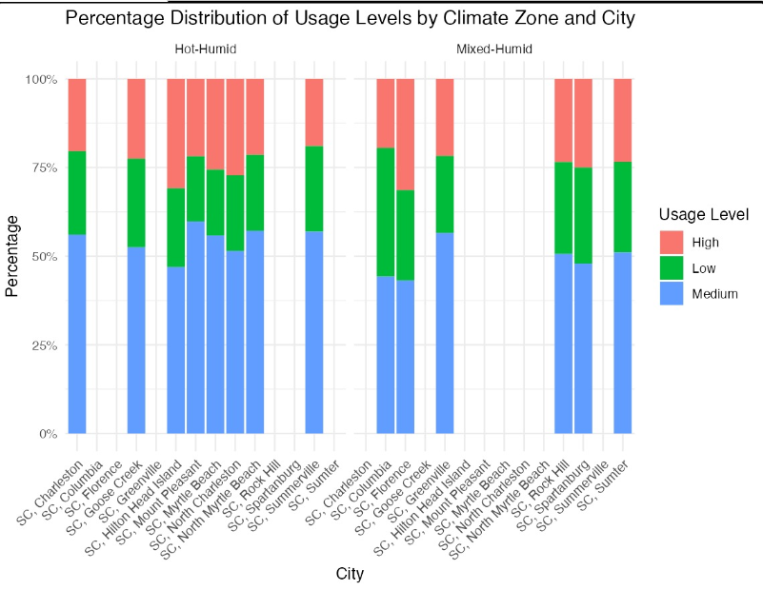
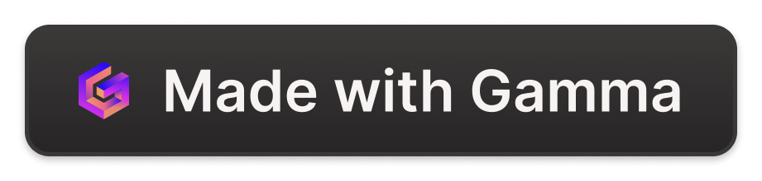
Predicted Daily Energy Consumption(City Wise)
From this bar graph , we can
understand how usage levels vary across different cities within various climate zones

Slide 7
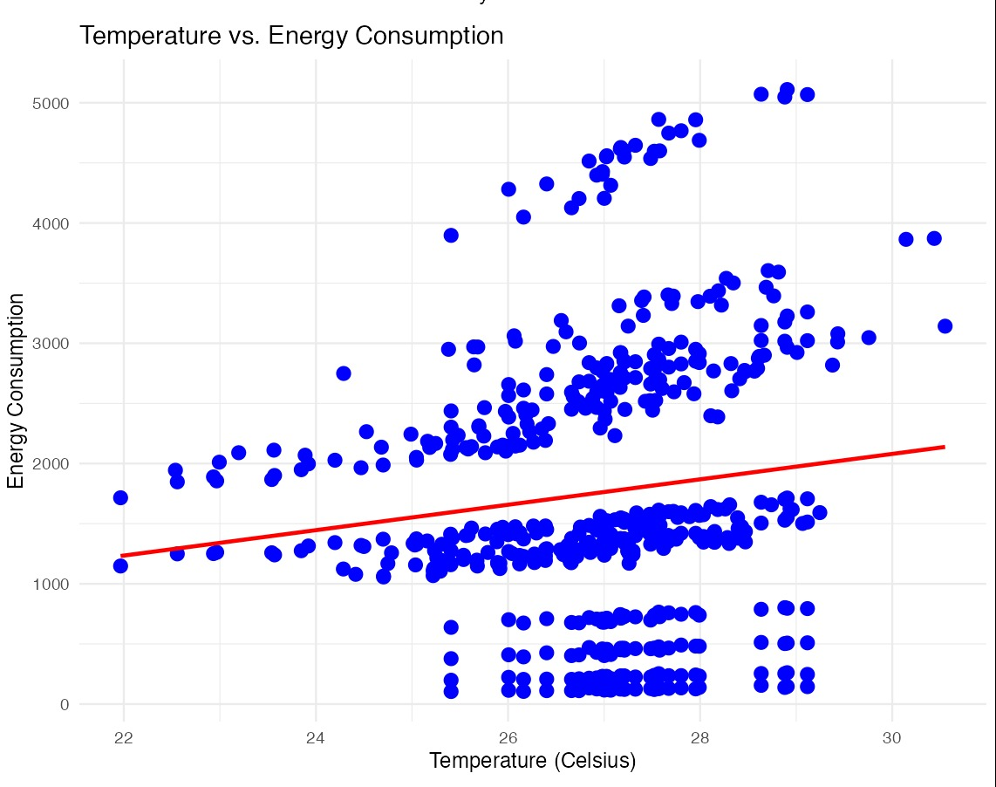
V
Energy Consumption vs Temperature
This graph gives us positive correlation between temperature and energy consumption within the specified data set, focusing on South Carolina and North Carolina.
This positive trend indicates that as temperatures rise, there is a corresponding increase in energy consumption in these regions.

Slide 8
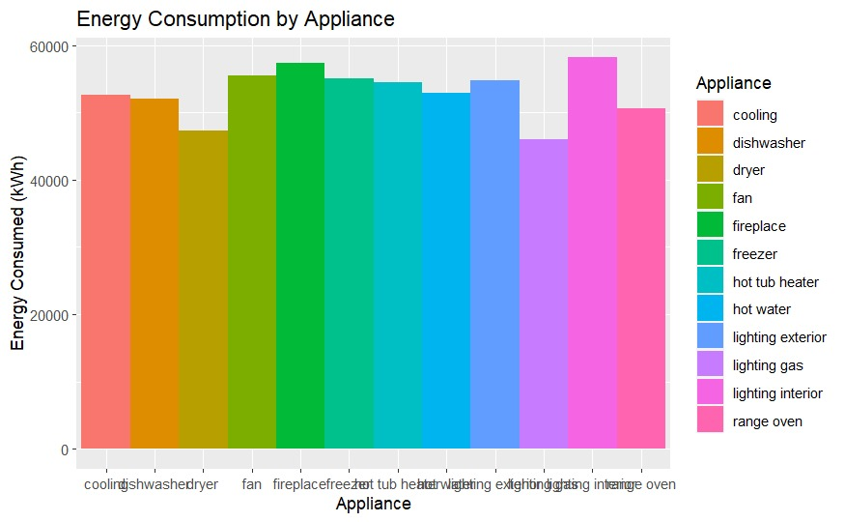
Energy Consumption by Appliances

Slide 9


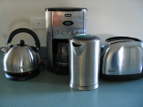
Factors Affecting Energy Consumption
1
Household Characteristics
2
Weather Conditions
3
Appliances used
Sqft Bedrooms Stories Occupants sum_lighting_exterior sum_lighting_interior
Temperature
Humidity
ceiling_fan cooling freezer hot_water lighting_exterior lighting_interior
Fire place
Hot_tub_heater
Dish washer
Dyer
Lighting gas
Range oven refrigerator

Slide 10

th
Identifying a Potential Approach to Reduce Peak Energy Demand
1
Data Analysis
The top three variables contributing towards energy consumption are:
Interior Light
Fire place
Ceiling fan
2
Reasons for High Usage
Ceiling Fan – in the summer, hot weather can lead to higher usage along with keeping them constantly running
Interior Light – homeowners keep their interior lights on throughout the night / while going out
Fire place – fireplace is also consuming much energy as they put outside for outdoor décor

Slide 11
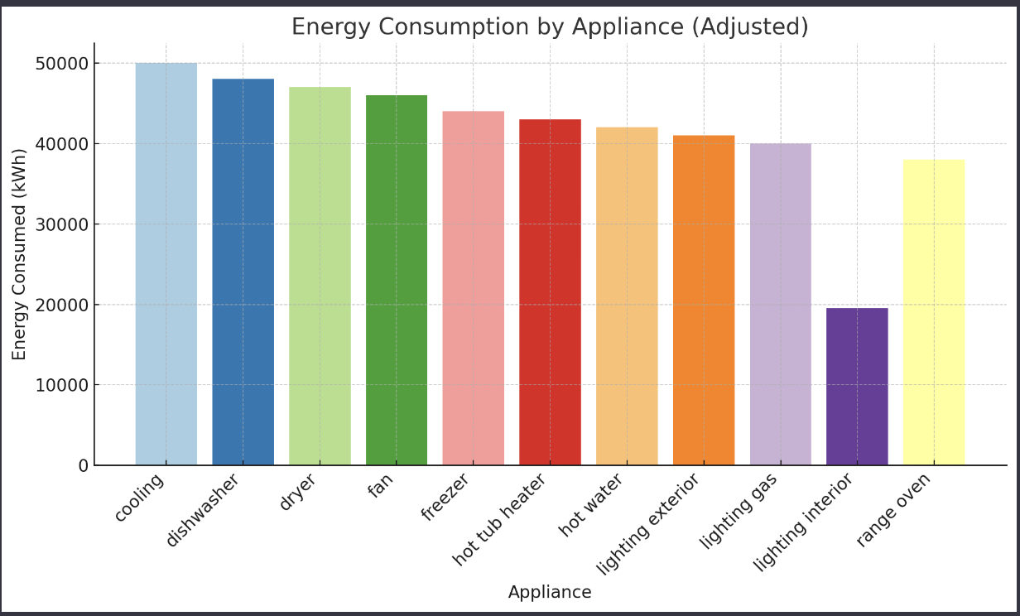
Recommendation
Here the first recommendation is to remove the fireplace usage in summer and decrease the interior light usage
Hence we can see that the energy consumption is reduced to almost 5000 kWH

Slide 12

Conclusion
Understanding Energy Consumption
Sustainable Energy Future
Continuous Research
Continued research in this field will lead to improved energy management and a greener future for all.
By analyzing various factors and employing advanced techniques, we gained insights into energy consumption patterns and its impact on society.
Our findings can contribute to the development of sustainable energy strategies and encourage energy-saving practices.

Slide 13
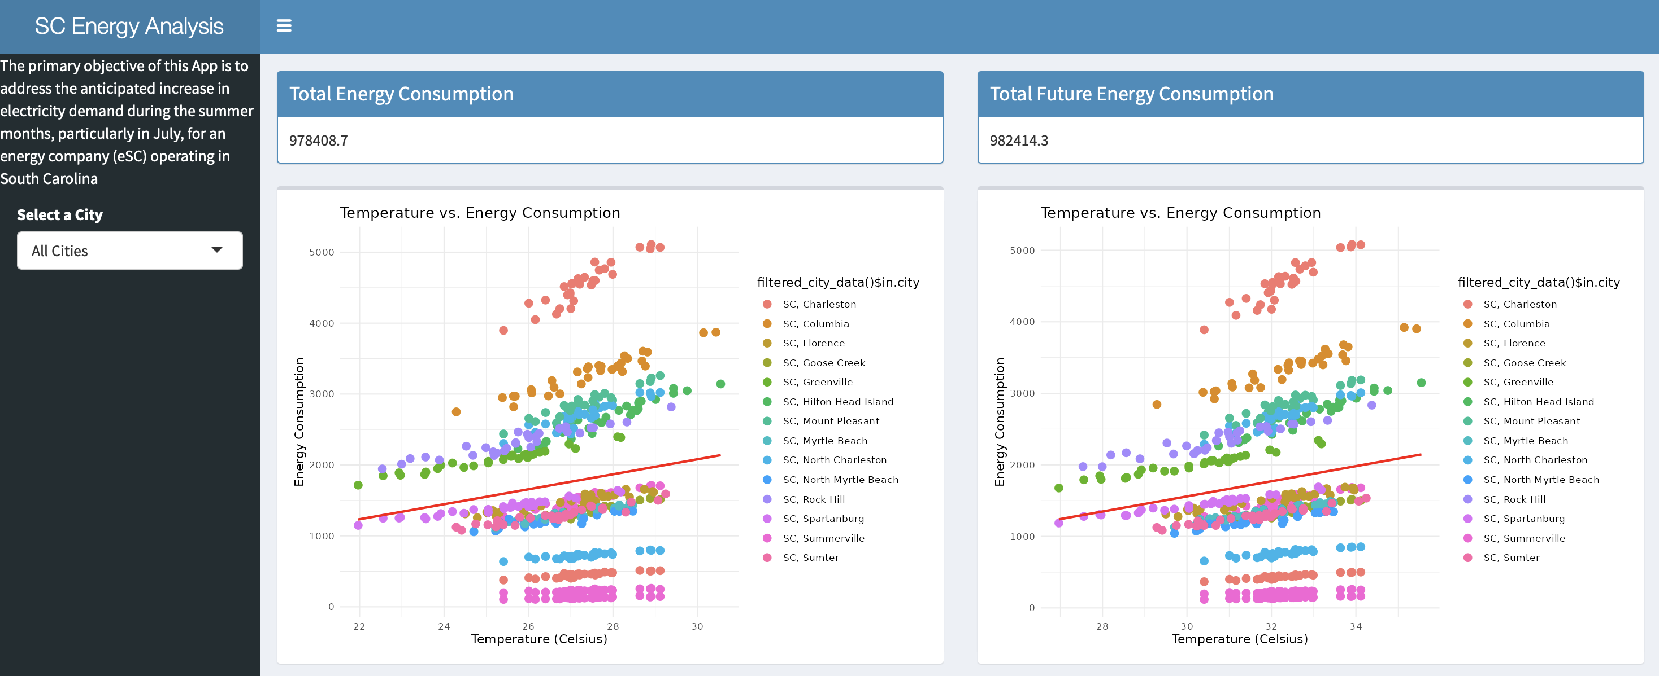
SHINY APPS
https://sbadampuakhil.shinyapps.io/IDSShiney1/

Slide 14
THANKYOU SO MUCH

